Slide 1
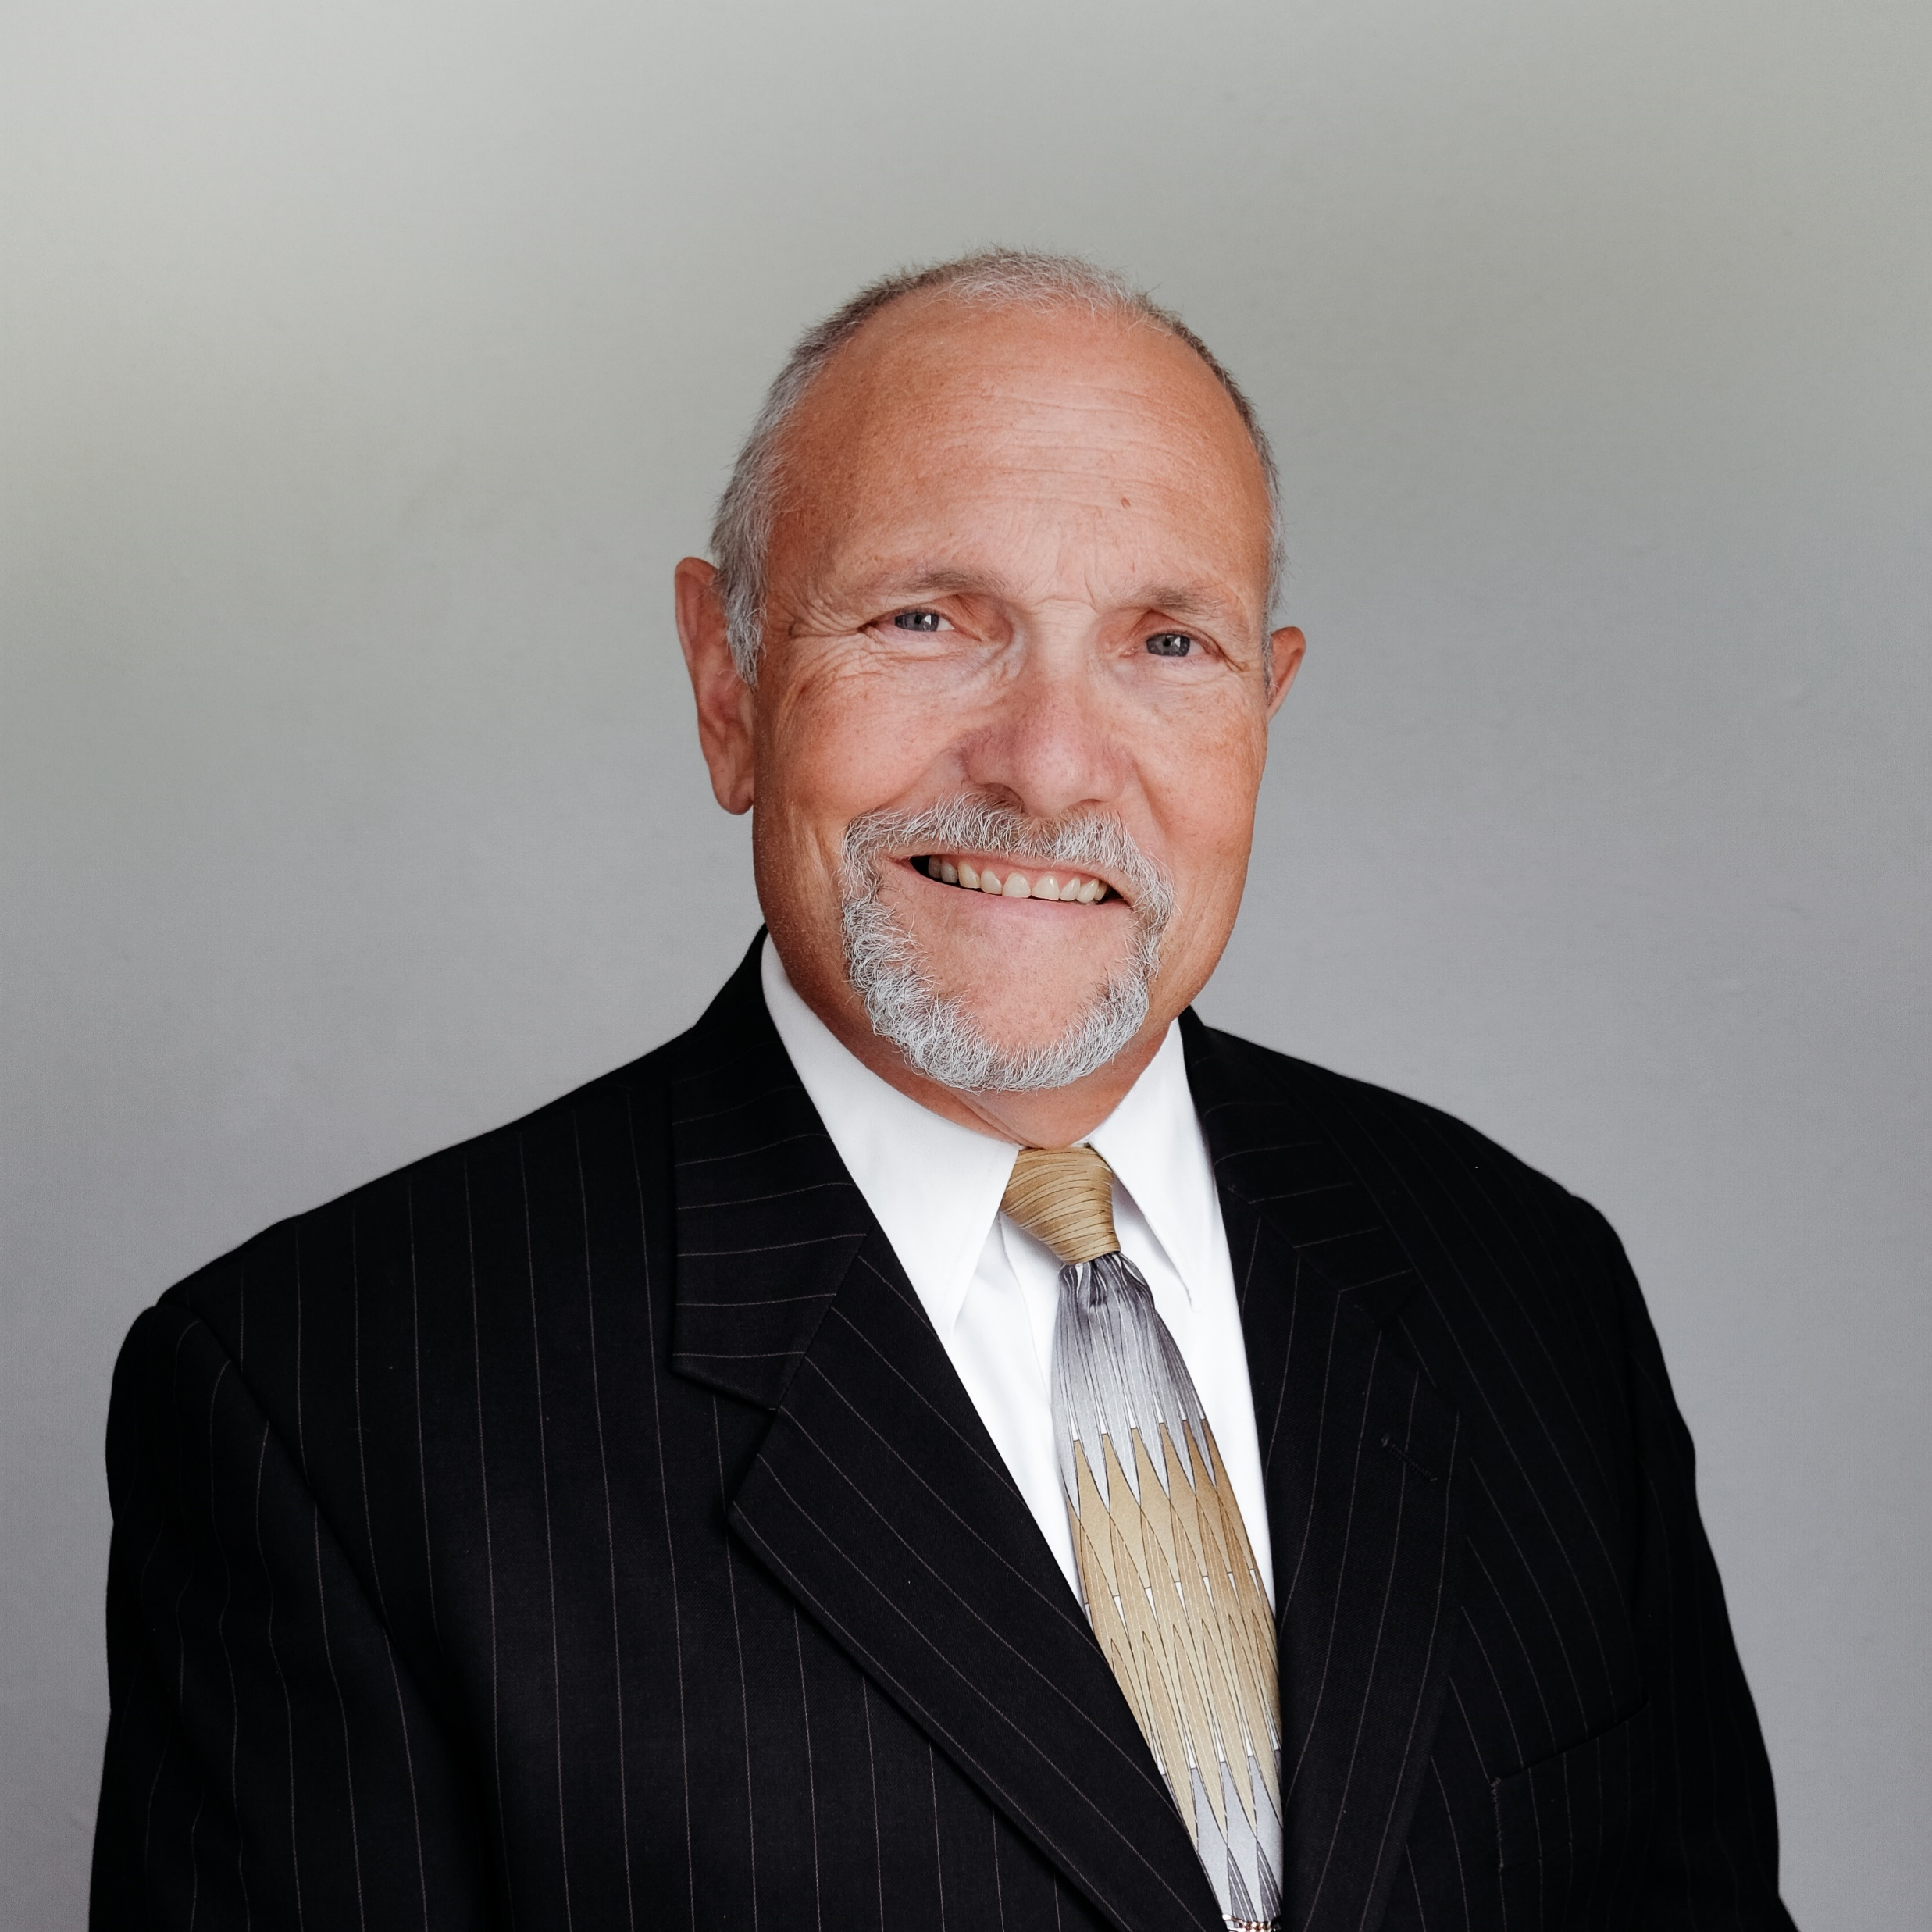
Faithfulness in Stewardship:
The Minister as
Financial Counselor and Leader
Presented by
Corey A. Pfaffe, CPA, PhD
February 2021
Notes:
Workshop #1, Faithfulness in Stewardship: The Minister as Financial Counselor and Leader
Ministers often find themselves as Biblical counselors to church members facing financial hardship. Corey teaches a truly Biblical and practical approach to integrity in matters of money. In his own counseling ministry, he has discovered three common ingredients to every successful family budget.
Ministers lead church and Christian ministry financial affairs rarely having received advanced training or gained business experience. Corey shares strengths and weaknesses that his team members at MinistryCPA have observed and helped church leaders address as they navigate financial waters and protect their ministries and people from financial shipwrecks.

Slide 2
REACHING GLOBALLY,
SERVING PERSONALLY
Four accounting professionals and three administrative staff located at offices in Watertown, Wisconsin
Church and Christian ministry clients in most U.S. States and virtually every Continent
Our Mission: To help others improve their financial stewardship
Notes:
This PowerPoint presentation and extensive material in the Notes Page View is available on our website under “Resources.”

Slide 3
Topics
The minister as financial counselor
The minister as financial leader
Complications for the Pastor as Financial Counselor
Faithfulness in Stewardship: The Minister as Financial Counsellor and Leader
Notes:
Ministers often find themselves as Biblical counselors to church members facing financial hardship.
Ministers leading church and Christian ministry financial affairs rarely having received advanced training or gained business experience. Even with a team of financial experts around him, his followers expect him to discern best practices.
A godly and faithful couple in your church comes to you and shares their story:
“Pastor, thank you for your faithful visits to the hospital while we have spent so many days and nights in the hospital with our son. We now face hundreds of thousands of dollars in debt and can see no way out. Several have advised us to file for bankruptcy. What biblical counsel can you give us?”
Where do you turn? What counsel can you offer?
Or, how about this story? It comes from another member of your church:
“Pastor, I know that I should have been so clueless, but my spouse has run up tens of thousands in consumer debt, even breaking the law in the process.”
“What biblical counsel can you give me?”
Where do you turn? What counsel can you offer?
Certainly, there are books that you can direct them to for some of these answers. But they are looking to you for Bible truth. These are gnarly problems and you may very well be intimidated to answer, but there are several common issues that complicate pastors’ ability to serve these acute needs:
Need to review Bible truths addressing financial matters
Lack of knowledge of trusted resources available from both Christian and non-Christian counselors.
Challenges in their own family finances.
Church financial affairs are not well ordered, therefore destroying credibility of the church to address matters of family finances.
It is for the sake of this final complication—church financial affairs as a credible model of wisdom and integrity—that I will first, but briefly, address. For the minister—regardless whether he feels ready—is viewed by the church body as their ultimate leader, including in matters of finances.

Slide 4
The Minister as Financial Leader
Financial leadership strengths and weaknesses we see at
Faithfulness in Stewardship: The Minister as Financial Counsellor and Leader
Notes:
Picture: Calvary Baptist Church, Watertown, Wisconsin
Few churches require what CPAs refer to as an Independent Audit. Further, audits rarely address the financial management issues that affect the day-to-day decisions and realities of ministry.
MinistryCPA professionals are trained to conduct independent audits but instead of performing them, we often assist as “insiders” helping prepare ministries for audits. When no audit is required or beneficial, we have been engaged for what we have come to call an operational review.
We review church financial reports, budgets and various documents. We interview their pastors, staff and lay leaders in areas of financial stewardship.
These procedures look at
safeguards for the receipt and disbursement of funds,
budget development and reporting practices,
compensation challenges and opportunities, and
other areas depending on the needs and interests of the church.
Of course, every church is unique but following are some common themes we see.

Slide 5
Financial Leadership Strengths
Personal integrity
Value laypeople with training and experience in organizational finance
Willingness to learn
Faithfulness in Stewardship: The Minister as Financial Counsellor and Leader
Notes:
Most ministers have learned to live within their means and that carefulness extends to their financial leadership in the church body.
$19 – It’s the amount I remember as a 10-year-old boy that my Baptist pastor dad mentioning as the reason he spent several hours late into the night with his church treasurer in the days leading up the annual business meeting. The checkbook didn’t balance by $19.
Most pastors realize that if the church finances are a mess, people lose confidence in a lot more than finances.
https://unsplash.com/photos/oUiTrFhnEkE

Slide 6
Financial Leadership Weaknesses
Lack of personal knowledge
Lack of knowledge by staff and volunteers
Lack of protection for the ministry and for those serving
Faithfulness in Stewardship: The Minister as Financial Counsellor and Leader
Notes:
Many ministers have little training or experience in leading the financial management of any organization.
Also, the people overseeing financial matters often have little experience in NFP matters (results of brainstorm with MinistryCPA team):
Trouble recording transactions outside routine receipts and disbursements
Lack experience in preparing and presenting reports that are conscious of users’ needs and understanding. The pastor, his associates, lay leaders and members of the congregation aren’t sure what the reports are telling them and what decisions they should lead to.
They are not sure what to do to wisely account for designated gifts and their disbursement
Unfamiliar with the nuances of ministerial compensation and benefits compliance and opportunities
Internal controls—I Corinthians 16.1-4 – The apostle Paul was concerned about financial accountability to protect the ministry AND those who handled the finances.
¹ Now concerning the collection for the saints, as I have given order to the churches of Galatia, even so do ye.
² Upon the first day of the week let every one of you lay by him in store, as God hath prospered him, that there be no gatherings when I come.
³ And when I come, whomsoever ye shall approve by your letters, them will I send to bring your liberality unto Jerusalem.
⁴ And if it be meet that I go also, they shall go with me. (i.e., “I’m not carrying a bag full of money all the way to Jerusalem by myself.”)
It is never right to assign someone to a position of financial responsibility who in spite of impeccable integrity has been left open to suspicion of unfaithfulness in matters of money.
No one person should ever be left alone in the custody of uncounted cash.
https://unsplash.com/photos/oUiTrFhnEkE

Slide 7
“What do we do? We’re truly at Ground Zero in terms of financial leadership.”
Keep it simple
Create a budget and use it
Learn about ministerial compensation
Track designated gifts
Try not to “live on the edge”
Protect your people and the ministry
Get help
Faithfulness in Stewardship: The Minister as Financial Counsellor and Leader
Notes:
Keep it simple—Start your bookkeeping process and reports with a simple cash basis. Cash in; cash out. Reports showing the beginning cash balance, plus cash in, minus cash out and ending with ending cash balance.
Create a budget and use it—Forecast income and authorize expenses as best you can for year one. Start comparing it regularly to interim totals of cash in and cash out.
Learn about ministerial compensation
Richard Hammar’s annual Church & Clergy Tax Guide
Dan Busby’s annual Zondervan’s Minister’s Tax and Financial Guide
IRS website Ministers Audit Techniques Guide (2009 publication date, but it’s very helpful)
MinistryCPA blog
Track designated gifts—it’s a stewardship AND a legal duty
Try not to “live on the edge”—rule of thumb: hold 15% of your annual expenditures in reserve; it’s not hoarding
Protect your people and the ministry—establish accountability over cash in and cash out
Get help—ask potential advisors about their experience with churches and get references

Slide 8
The Minister as Financial Counselor
Bible foundation for the Christian financial counselor
Three key components of every successful family budget
Resources for personal financial knowledge
Faithfulness in Stewardship: The Minister as Financial Counsellor and Leader
Notes:
With demonstrated faithful stewardship as the Financial Leader of the church, the minister gains credibility as a Financial Counselor.
Let’s briefly examine these three areas.

Slide 9
Bible Foundation: Integrity in Matters of Money
Ecclesiastes 4.9-12
An arsenal of weapons
The Bible – Psalm 119.11
The Spirit – Galatians 5.25
Christian friends (accountability)
Spouse – Proverb 18.22 and I Peter 3.7
Others – II Samuel 1.26 and Ecclesiastes 4.9-12
Faithfulness in Stewardship: The Minister as Financial Counsellor and Leader
Notes:
As a Christian counselor you want to disciple your brother or sister in Christ who is facing financial hardship—whether of his own doing or due to matters largely out of his control. So you must lay a Biblical foundation for your financial counsel.
Ecclesiastes 4.9-12 (KJV) –
⁹ Two are better than one; because they have a good reward for their labour.
¹⁰ For if they fall, the one will lift up his fellow: but woe to him that is alone when he falleth; for he hath not another to help him up.
¹¹ Again, if two lie together, then they have heat: but how can one be warm alone?
¹² And if one prevail against him, two shall withstand him; and a threefold cord is not quickly broken.
I have come to believe that there is a threefold cord of weapons available for the arsenal of a follower of Christ who greatly desires a life and testimony of personal holiness and integrity—integrity in matters of morality, the mouth and money.
Psalm 119.11 – Thy word have I hid in mine heart, that I might not sin against thee. [Offer Scripture to memorize and remind themn of stewardship principles.]
Galatians 5.25 – If we live in the Spirit, let us also walk in the Spirit. [Encourage sensitivity to the Spirit of God who indwells them.]
Proverb 18.22 – Whoso findeth a wife findeth a good thing, and obtaineth favour of the Lord. [Team them that communication must be transparent in the home.]
I Peter 3.7 – Likewise, ye husbands, dwell with them according to knowledge, giving honour unto the wife, as unto the weaker vessel, and as being heirs together of the grace of life; that your prayers be not hindered.
II Samuel 1.26 – I (David) am distressed for thee, my brother Jonathan: very pleasant hast thou been unto me: thy love to me was wonderful, passing the love of women. [Encourage accountability to mature fellow believers.]

Slide 10
Bible Foundation: Integrity in Matters of Money
Proverb 22.3
Proverb 22.7
The Costs of Debt
Interest—the borrow pays more than the amount he borrows
Servitude—the borrower has promised his future earnings in exchange for a current purchase
Faithfulness in Stewardship: The Minister as Financial Counsellor and Leader
Notes:
Scriptural to teach and memorize…
1. Proverb 22.3 – A prudent man foreseeth the evil, and hideth himself: but the simple pass on, and are punished.
The benefits of prudent financial practices and the consequences of ill-advised ones are easily foreseen.
Many of the “evils” of financial ruin are predictable. There are multiple honorable ways to hide.
Saving toward predictable major expenses or purchases—replacing a vehicle; Christmas spending; vacations
Saving toward likely but unpredictable major expenses or purchases—health care; emergency travel; car repairs
Preventive maintenance of possessions
Arranging appropriate insurance against risks that one cannot assume alone
2. Proverb 22.7 – The rich ruleth over the poor, and the borrower is servant to the lender.
It is a fact of life that those who have assumed the risks of entrepreneurial pursuits and now find themselves employing others to help multiply their enterprises will rule over employees who look to them for jobs. Similarly, it is a fact of life that those who borrow money will be required to serve those who lend.
What are the costs of debt?
Corey’s definition of debt: An exchange of future earnings for a current benefit at a cost of interest and servitude.
3. When Christians commit too much of their future earnings to paying for current purchases they sometimes believe they cannot practice biblical giving. A biblical counsellor may find it important to explore giving with others as well.
God’s Way of Giving—4 pervasive Bible themes:
God gives to us. He is the ultimate giver of all gift “material.” Christians can only be responsive givers.
Christians respond (in this order) by
Giving Thanks,
Giving to God’s work and His workers, and
Giving to Others.
The New Testament teaches proportional giving (“as God has prospered you” (I Corinthians 16.2)). Even the extremely tight budget must find some room for giving. As God prospers, families should increase their proportion until they rise to a level of biblical obedience in terms of giving.

Slide 11
Three key components to every successful budget
a plan for monthly INs and OUTs
a plan to use the monthly budget each pay period
a plan to stay on track between pay periods
Faithfulness in Stewardship: The Minister as Financial Counsellor and Leader
Notes:
A monthly budget balancing what is expected to come IN versus what is expected to go OUT on a monthly basis
Assigning expenses to each pay period using monthly budget
Between pay periods (Larry Burkett’s Cash Envelope system?)
Monthly budgeting: When I meet with couples in financial trouble who seek my help, I often call this the “Kleenex stage” because it can be hard and stressful work creatively figuring out how to “balance the budget.”
Monthly budgeting: Balancing what is expected to come IN versus what is expected to go OUT on a monthly basis. We all experience:
expenses each pay period
expenses each month
expenses sporadically throughout the year (“budget busters”) annual total / 12 each month
assign all expenses to either 2 or 4 pay periods each month
“free” checks
Picture: Larry Burkett’s 1980s Cash Envelope Systems as seen on Amazon.com

Slide 12
Destinations:
1 – save $1,000 for emergencies
2 – pay off credit cards
3 – pay off consumer debt
4 – adjust your plan
5 – save for the future
6 – invest wisely
7 – leave a legacy
Family Budgeting: Resources
Baby Steps:
1 – save $1,000 for emergencies
2 – pay off all debt (except the house)
3 – save three to six month’s expenses
4 – save 15% of income into retirement
5 – save for your children’s college education
6 – pay off mortgage early
7 – build wealth and give
Faithfulness in Stewardship: The Minister as Financial Counsellor and Leader
Notes:
Popular resources for personal financial knowledge (www.DaveRamsey.com and Crown Financial Ministries: www.Crown.org)

Slide 13
REACHING GLOBALLY,
SERVING PERSONALLY
Our Mission: To help others improve their financial stewardship
Notes:
This PowerPoint presentation and extensive material in the Notes Page View is available on our website under “Resources.”

